Slide 1
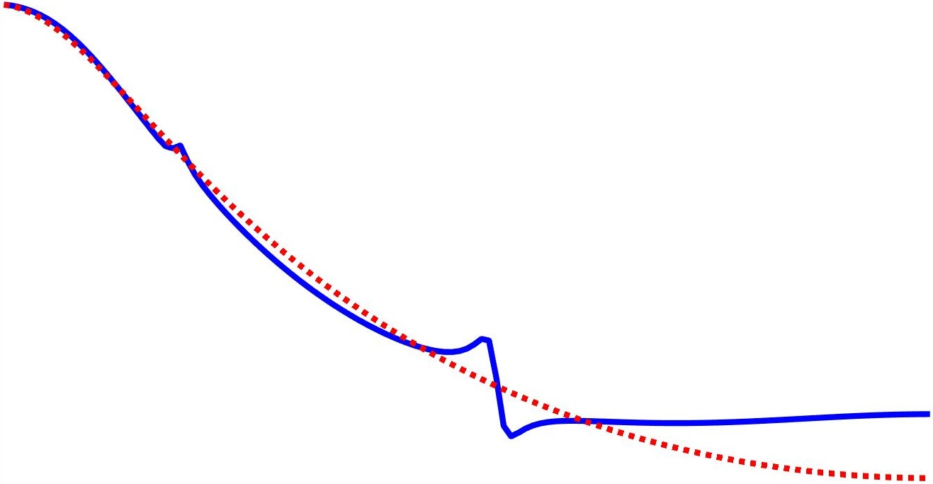
A frequency domain approach to data-driven control
Marc Berneman
With the supervision of Prof. Dr. Ir. Rik Pintelon
and the co-supervision of Prof. Dr. Ir John Lataire

Slide 2
Table of contents
LTI systems
Frequency domain approach
Data-driven control
Simulations
Experiment
Conclusion

Slide 3
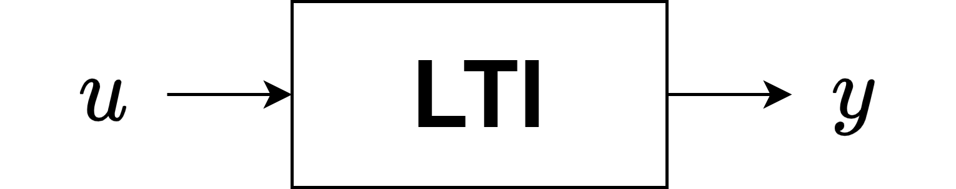
LTI systems

Slide 4
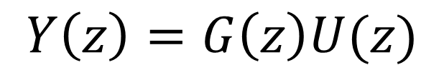
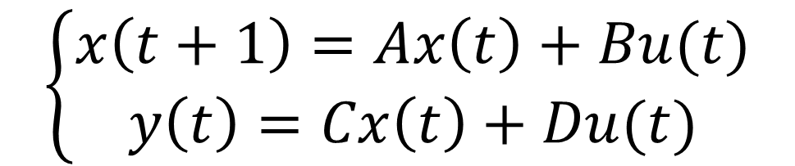
LTI systems
Single-input single-output
Linear Time-Invariant System
$$\left\{\begin{aligned}x\left(t+1\right)=Ax\left(t\right)+Bu(t) \\ y\left(t\right)=Cx\left(t\right)+Du(t)\end{aligned}\right.$$
$$Y\left(z\right)=G\left(z\right)U(z)$$
Transfer function
State space

Slide 5
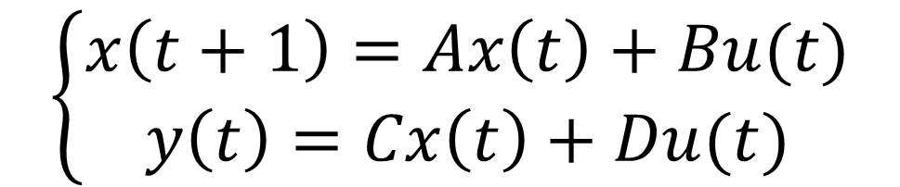

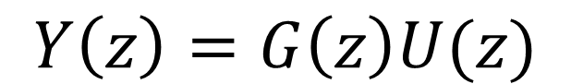

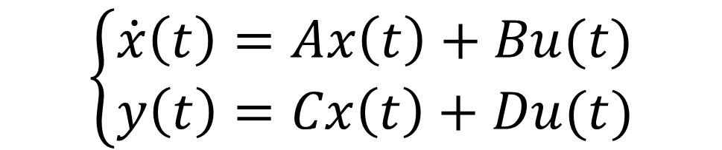
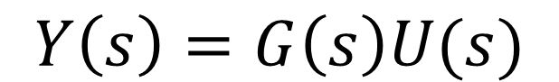
LTI systems
Transfer function
State space
Discrete time
$$\left\{\begin{aligned}x\left(t+1\right)=Ax\left(t\right)+Bu(t) \\ y\left(t\right)=Cx\left(t\right)+Du(t)\end{aligned}\right.$$
$$Y\left(z\right)=G\left(z\right)U(z)$$
Continuous time
$$\left\{\begin{aligned}\dot{x}\left(t\right)=Ax\left(t\right)+Bu(t) \\ y\left(t\right)=Cx\left(t\right)+Du(t)\end{aligned}\right.$$
$$Y\left(s\right)=G\left(s\right)U(s)$$
$$G\left(Ω\right)$$
$$Ω=s,z$$
Model
$$(A,B,C,D)$$

Slide 6
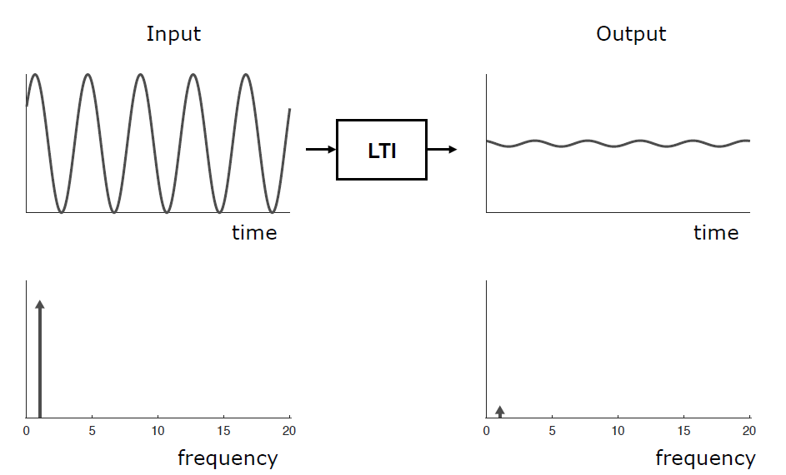
LTI systems
Ref. Lataire [2017]

Slide 7
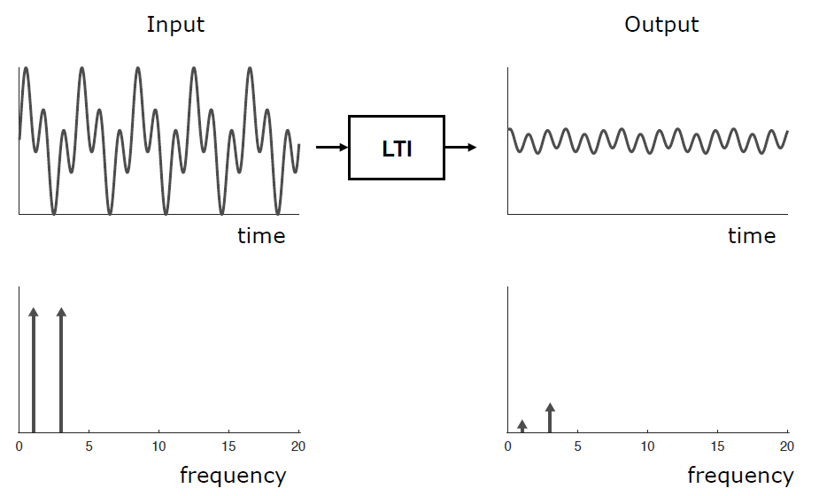
LTI systems
Ref. Lataire [2017]

Slide 8
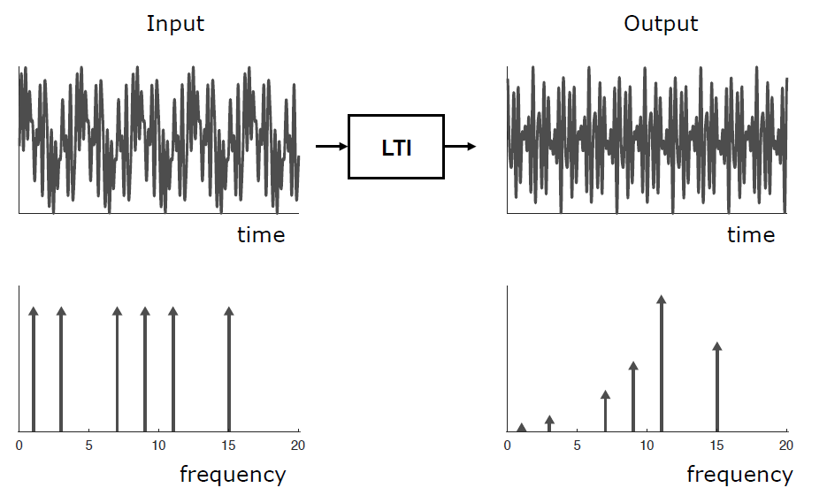
LTI systems
Ref. Lataire [2017]

Slide 9
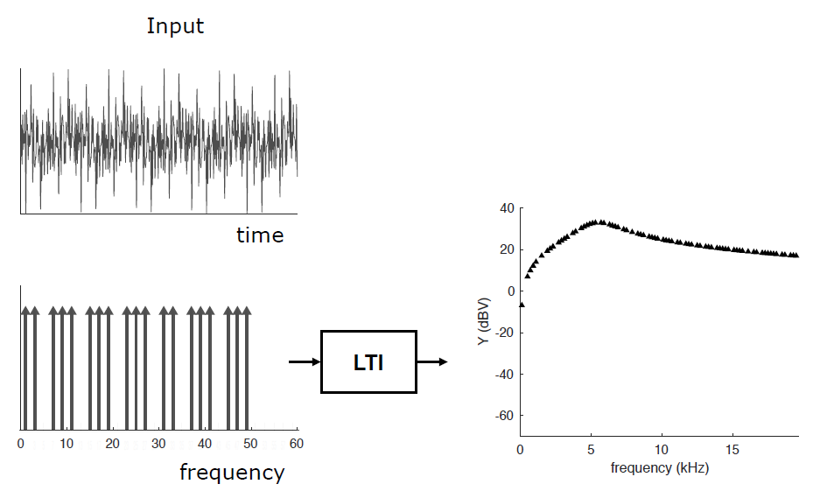
LTI systems
Multisine
Ref. Lataire [2017]

Slide 10
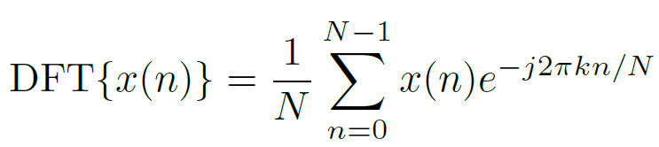
Discrete Fourier Transform

Slide 11
Discrete Fourier Transform
When does the DFT contain the same information as the Fourier Transform?

Slide 12
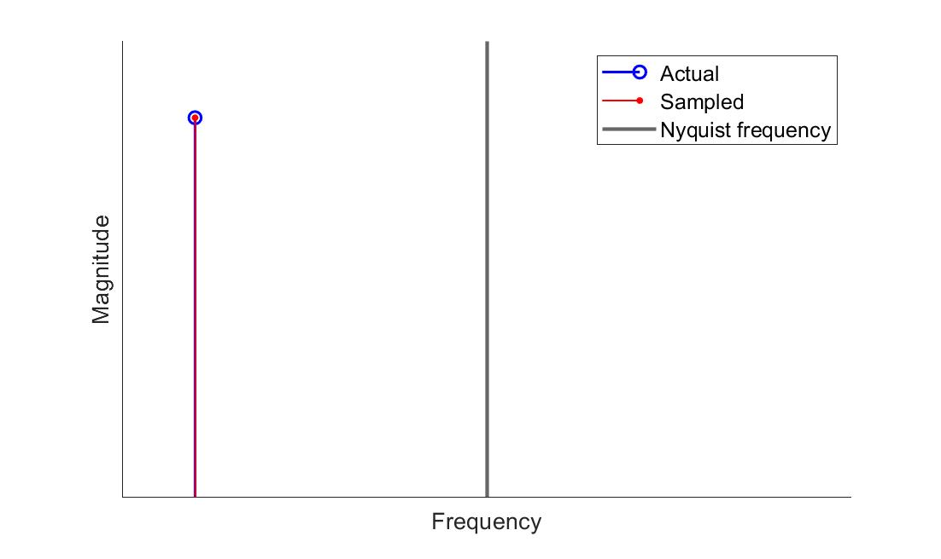
Discrete Fourier Transform
1. Nyquist-Shannon theorem

Slide 13
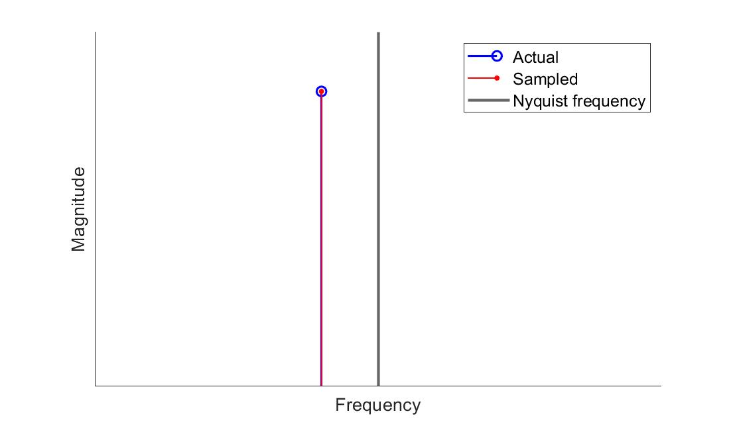
Discrete Fourier Transform
1. Nyquist-Shannon theorem

Slide 14
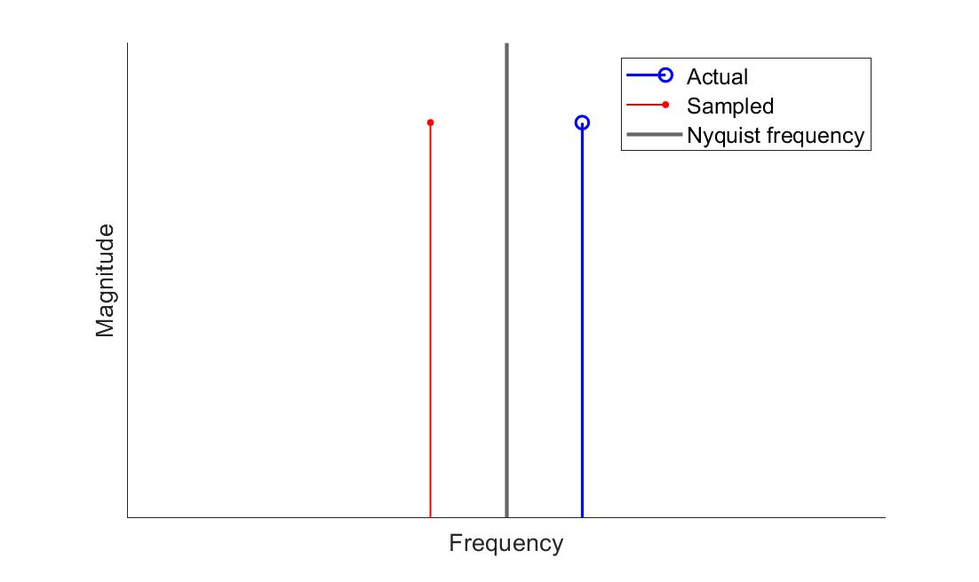
Discrete Fourier Transform
1. Nyquist-Shannon theorem

Slide 15
Discrete Fourier Transform
2. Periodicity
DFT assumes that the underlying signal is periodic for all time.

Slide 16
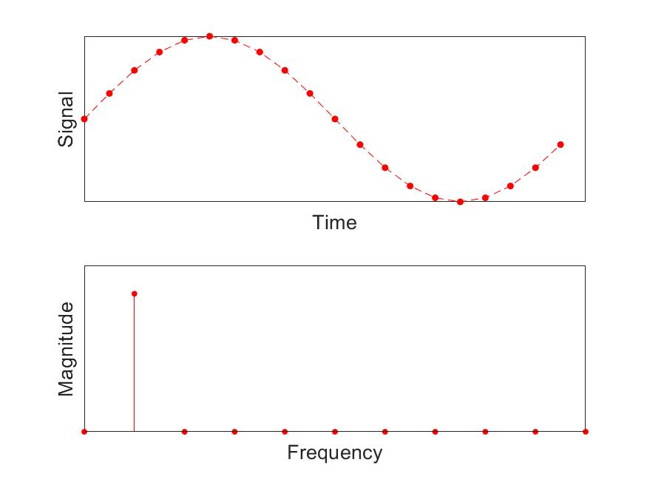
Discrete Fourier Transform
3. Leakage

Slide 17
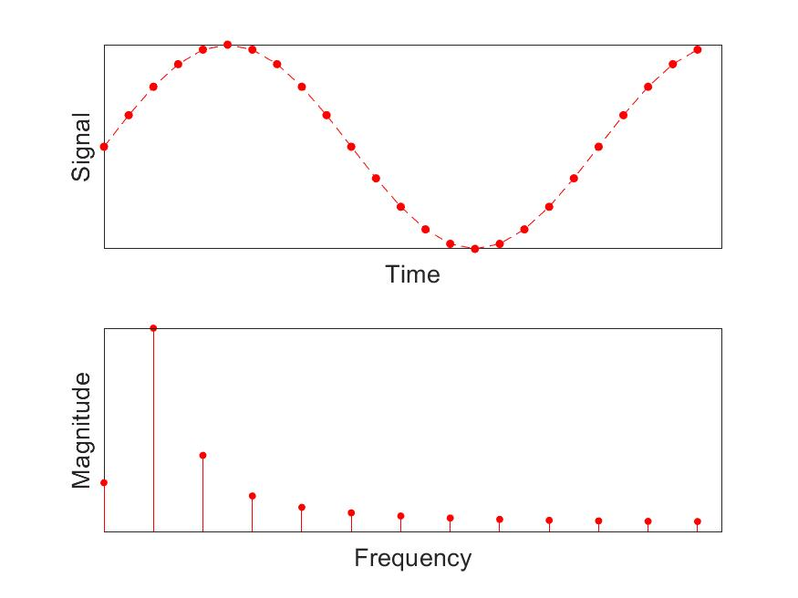
Discrete Fourier Transform
3. Leakage

Slide 18
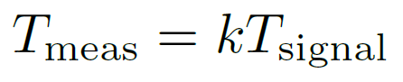
Discrete Fourier Transform
3. Leakage
The measurement time must contain an integer number of periods of the measured signal

Slide 19
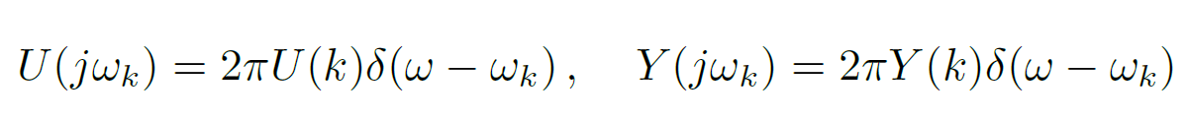
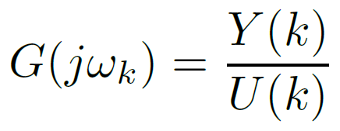
Discrete Fourier Transform
1. Nyquist-Shannon theorem
2. Periodicity
3. Leakage
Fourier spectrum
DFT spectrum

Slide 20
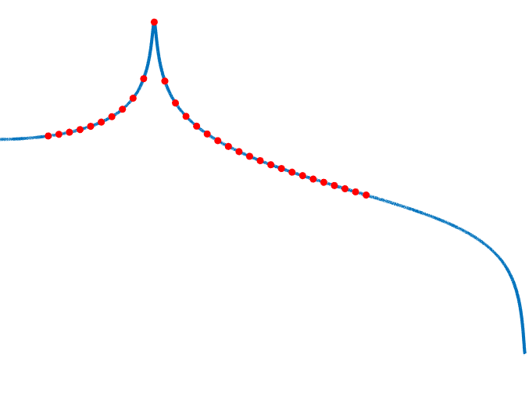
Frequency domain approach

Slide 21
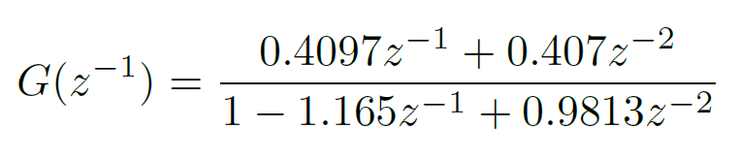
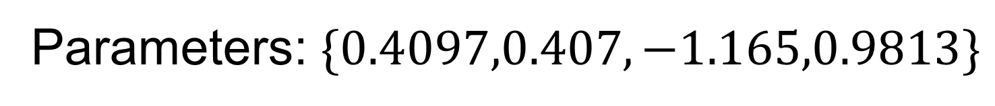
Frequency domain approach
Parametric model
Parameters: $\{0.4097,0.407,−1.165,0.9813\}$
Nonparametric model?

Slide 22
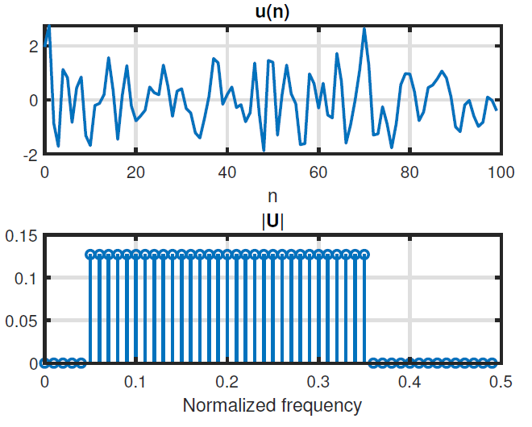
Frequency domain approach

Slide 23
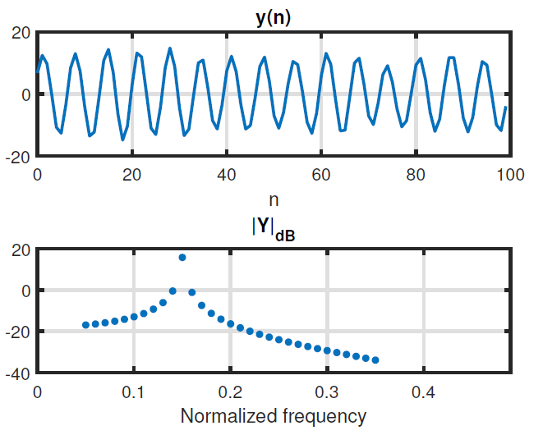
Frequency domain approach

Slide 24
Frequency domain approach

Slide 25
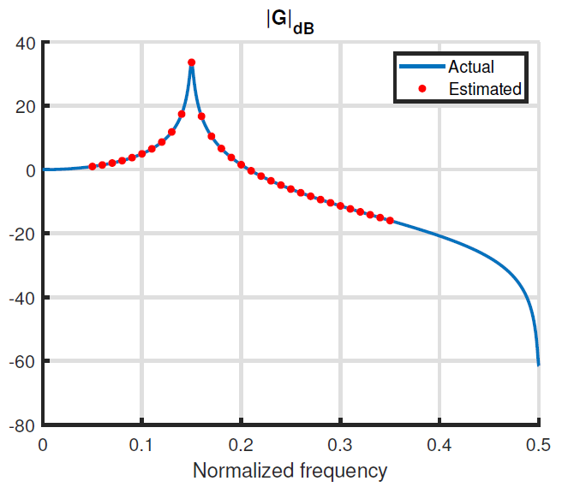
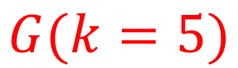
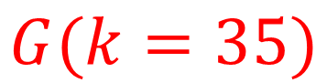
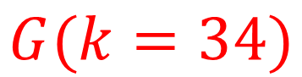
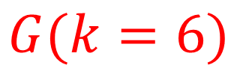
Frequency domain approach
$$G(k=34)$$
$$G(k=5)$$
$$G(k=35)$$
$$G(k=6)$$

Slide 26
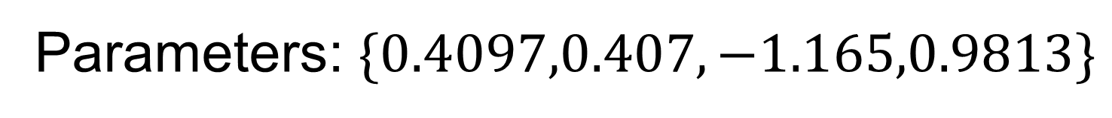
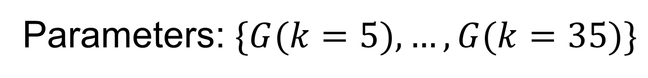
Frequency domain approach
Nonparametric model
Parameters: $\{G(k=5),…,G(k=35)\}$
Number of parameters can grow with the amount of data
Parametric model
Parameters: $\{0.4097,0.407,−1.165,0.9813\}$

Slide 27
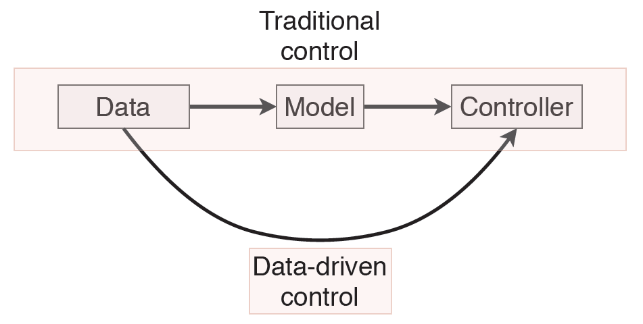
Data-driven control

Slide 28
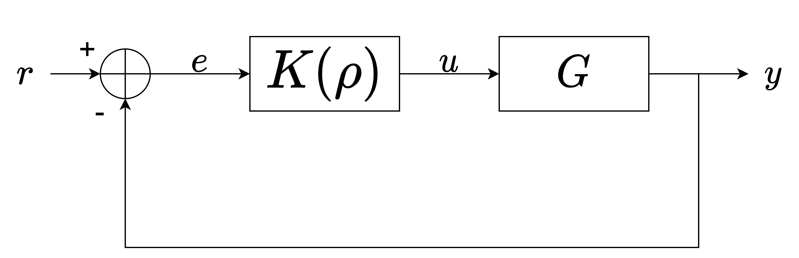
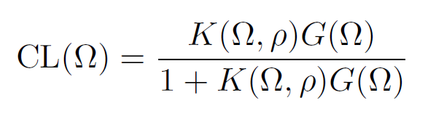
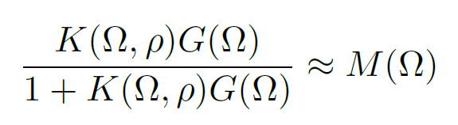
Data-driven control
User-defined reference model
“model reference control”

Slide 29
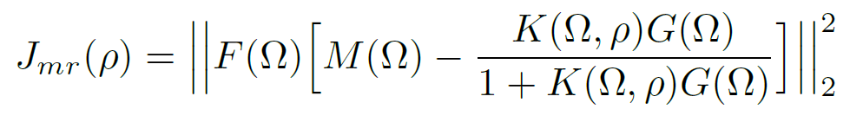
Data-driven control
Weighing filter
Not convex ☹

Slide 30
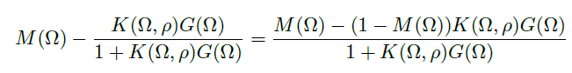
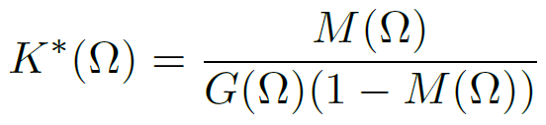
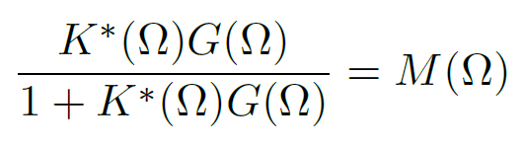
Data-driven control
Ideal controller:

Slide 31
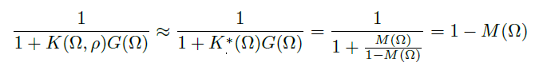
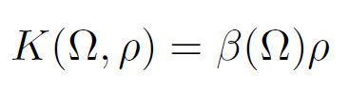
Data-driven control
Convex ☺

Slide 32
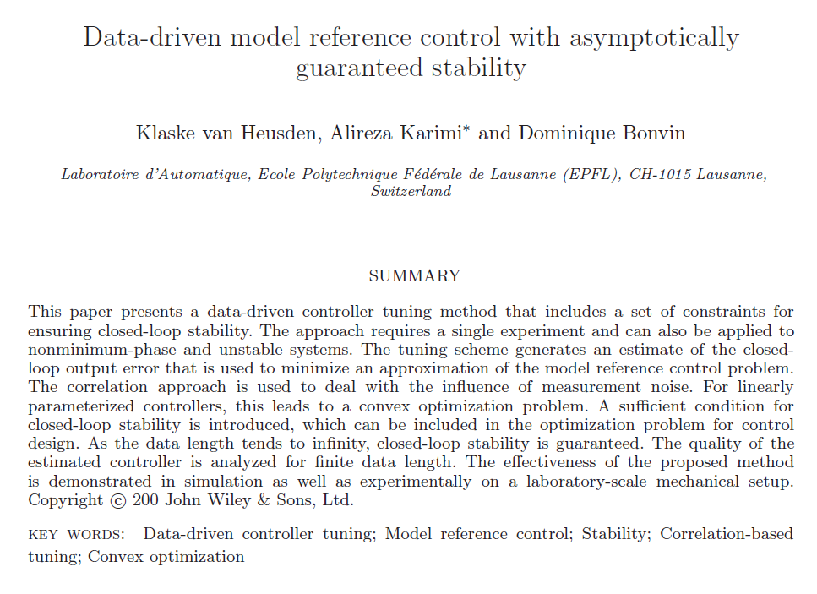
Data-driven control
Ref. van Heusden et al. [2011]

Slide 33
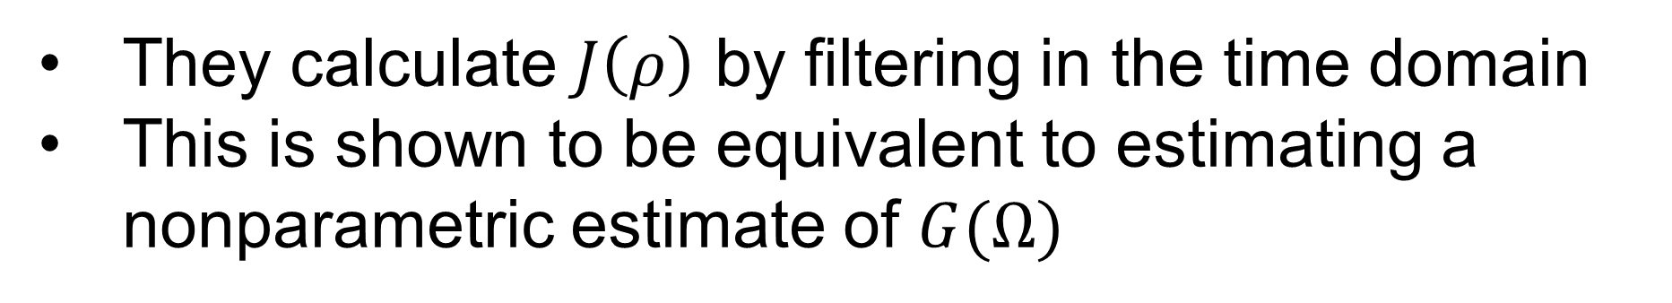
Data-driven control
They calculate $J\left(ρ\right)$ by filtering in the time domain
This is shown to be equivalent to estimating a nonparametric estimate of $G(Ω)$
Only possible for discrete time systems
Also possible for continuous time

Slide 34
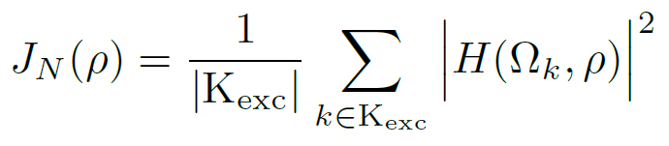
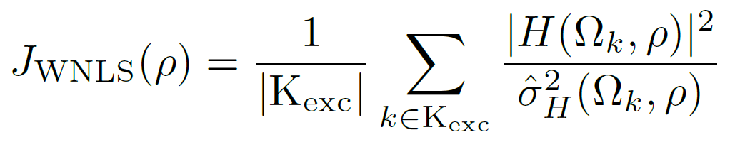
Data-driven control
Time domain
Ref. van Heusden et al. [2011]
Frequency domain
Excited harmonics
Weighted nonlinear least squares
Not convex ☹

Slide 35
Simulations

Slide 36
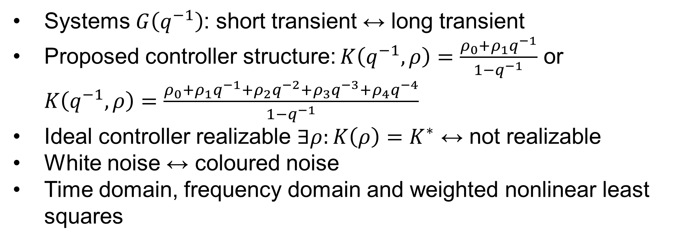
Simulations
Systems $G\left(q^{−1}\right)$: short transient ↔ long transient
Proposed controller structure: $K\left(q^{−1},ρ\right)=\frac{ρ_{0}+ρ_{1}q^{−1}}{1−q^{−1}}$ or $K\left(q^{−1},ρ\right)=\frac{ρ_{0}+ρ_{1}q^{−1}+ρ_{2}q^{−2}+ρ_{3}q^{−3}+ρ_{4}q^{−4}}{1−q^{−1}}$
Ideal controller realizable $∃ρ:K\left(ρ\right)=K^{∗}$ ↔ not realizable
White noise ↔ coloured noise
Time domain, frequency domain and weighted nonlinear least squares

Slide 37
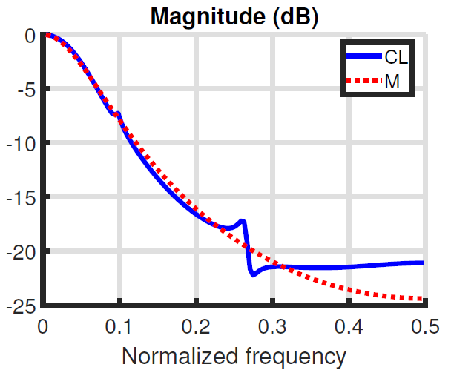
Simulations
Optimal closed loop (frequency domain) in the absence of noise
Ideal closed loop

Slide 38
Simulations
Method | Performance | Continuous time systems
Time domain | Best in general | ☹
Frequency domain | Comparable to time domain results. Sometimes attains better results. | ☺
Weighted nonlinear least squares | Very good for realizable controllers. Not good in other cases. No guarantee of convergence | ☺

Slide 39
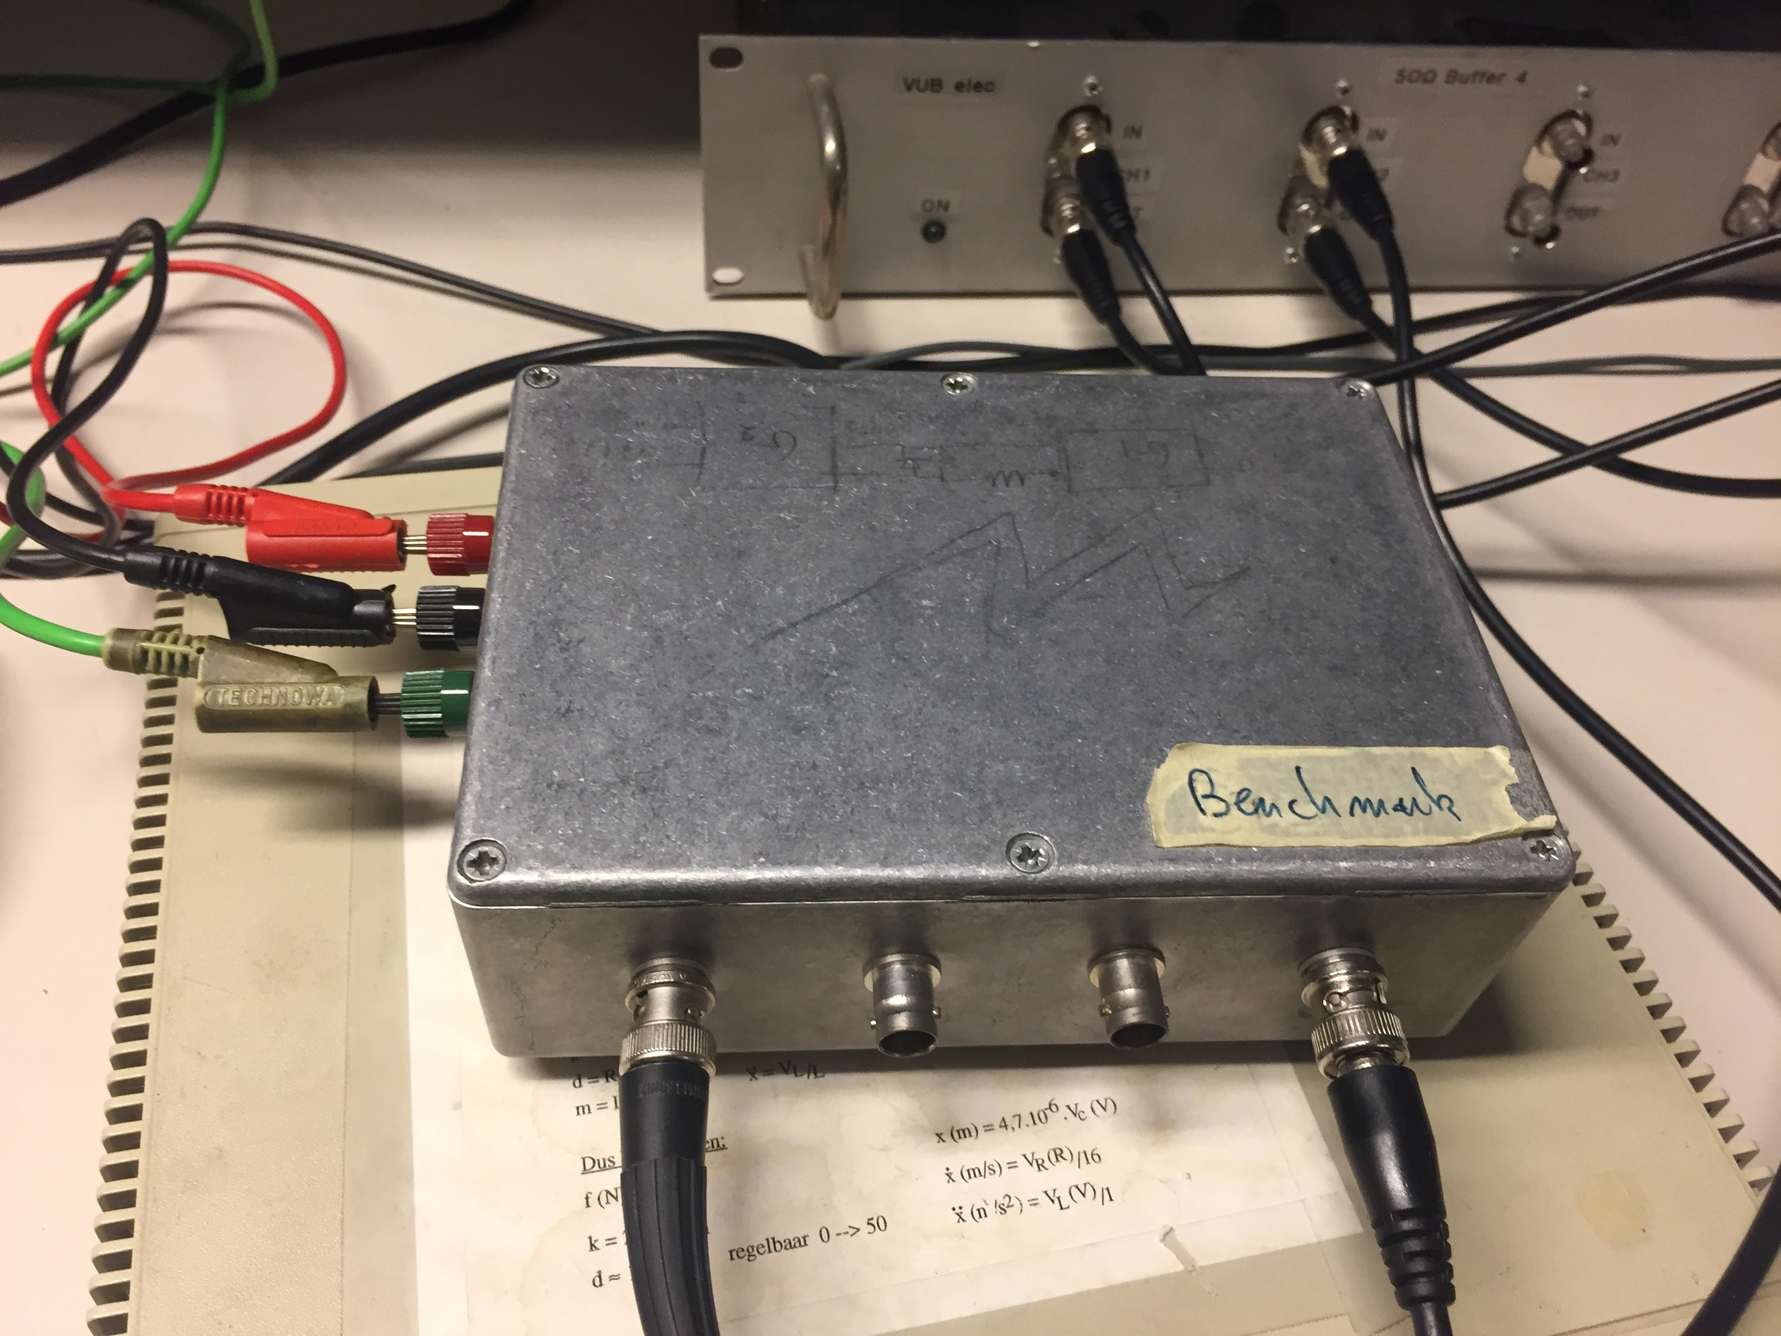
Experiment

Slide 40

Experiment
Robust local polynomial method
Ref. Pintelon and Schoukens [2012]
Best linear approximation
Random noise + nonlinear distortions

Slide 41


Experiment
PID

Slide 42

Experiment
Minimize

Slide 43

Experiment
Optimal closed loop
Ideal closed loop

Slide 44

Experiment

Slide 45

Experiment

Slide 46

Experiment
Nonparametric measurement of the controller ☹

Slide 47

Experiment
Nonparametric measurement of the closed loop system ☺

Slide 48



Experiment
Indirect measurement of the controller ☺
$$\frac{0}{0}$$

Slide 49
Conclusion

Slide 50
Conclusion
Time domain method works better for discrete time systems
Frequency domain method also works for continuous time systems
Weighted nonlinear least squares method gives a big improvement if the controller is realizable
Frequency domain method was successfully used to design an analog controller

Slide 51
References
TODO

Slide 52
subsection

Slide 53
Title
Sample text
Sample text 2
Image caption

